Slide 1
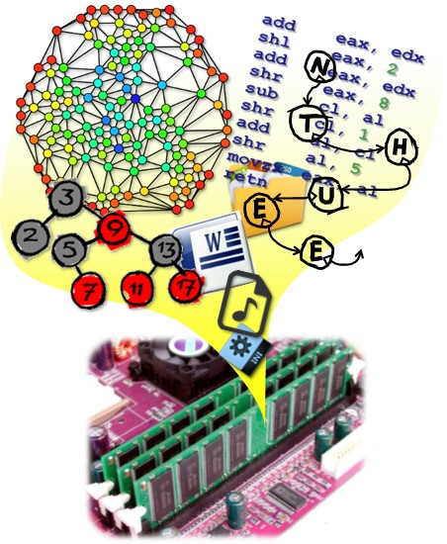
Data Structures
CH2 Arrays
Prof. Tai-Lang Jong
Office: Delta 928
Tel: 42577
email: tljong@mx.nthu.edu.tw
Spring 2021

Slide 2
Outline
2.1 Abstract Data Types and C++ Class
2.2 The Array as an Abstract Data Type
2.3 The Polynomial Abstract Data Type
2.4 Sparse Matrices
2.5 Representation of Arrays
2.6 The String Abstract Data Type

Slide 3
From int to class
Primitive data structure
Built-in
User-defined
Encapsulated
int
float
char
..
struct
union
array
class
“Computability” is not changed: They can solve the same set of problems.
Limited number of basic types
Unlimited number of desired types
Improved protection and reusability

Slide 4
Built-in Types
C++ natively supports integers and their operations
-1, 0, 1, 99, 1+99, 64/8
Rectangles with integral height and width are not natively supported
Using basic types to compute the area ratio of two rectangles is thus not very elegant
float ratio(int h1, int w1, int h2, int w2)
{
float area1 = h1 * w1;
float area2 = h2 * w2;
return (a1/a2);
};
This is not very elegant. The number of arguments becomes six if we want to handle cubes!

Slide 5
struct
struct Rectangle{
int h;
int w;
};
float ratio(Rectangle r1, Rectangle r2);
int main()
{
Rectangle a, b;
a.h = 4; a.w = 8; b.h = 5; b.w=20; //initialization
cout << ratio(a, b) << endl;
return 0;
}
float ratio(Rectangle r1, Rectangle r2)
{
float area1 = r1.h * r1.w;
float area2 = r2.h * r2.w;
return (area1/area2);
};
Rectangle acts as a user-defined type!
More elegant here!
Still not very elegant

Slide 6
struct with an Initialization Function
struct Rectangle{
int h; int w;
};
void initialize(Rectangle * r, int hi, int wi)
{
assert( hi > 0 && wi > 0 );
r->h = hi; r->w = wi;
return;
}
int main()
{
Rectangle a, b;
initialize(&a, 4, 8);
initialize(&b, 5, 20);
cout << ratio(a, b) << endl;
return 0;
}
A bit better, right?

Slide 7
struct with a Member Function
struct Rectangle{
int h; int w;
void initialize(int hi, int wi);
};
void Rectangle::initialize(int hi, int wi)
{
assert( hi > 0 && wi > 0 );
h = hi; w = wi;
return;
}
int main()
{
Rectangle a, b;
a.initialize(4, 8);
b.initialize(5, 20);
b.h = 0; //wrong value
cout << ratio(a, b) << endl;
return 0;
}
Initialize() becomes a member function of Rectangle.
“::”is Scope Resolution Operator
“Rectangle” is a scope in which this initialize() resides.
This is the best so far, but it would be better if the language can prevent users from:
forgetting to initialize a Rectangle
directly accessing the internal values of Rectangle

Slide 8
struct with a Constructor Function
struct Rectangle{
int h; int w;
Rectangle(int hi=1, int wi=1);
};
Rectangle::Rectangle(int hi=1, int wi=1)
{
assert( hi > 0 && wi > 0 );
h = hi; w = wi;
}
int main()
{
Rectangle a(4,8), b(5,20);
b.h = 0; //wrong value
cout << ratio(a, b) << endl;
return 0;
}
Rectangle() is the (default) constructor member function of Rectangle.
“::”is Scope Resolution Operator
“Rectangle” is a scope in which this Rectangle() resides.
This is the best so far. It prevent users from:
forgetting to initialize a Rectangle
But still can not prevent users from
directly accessing the internal values of Rectangle

Slide 9
A class
Four components of a class
A class name
Data members
Member functions
Levels of program access
Public: data or functions can be accessed from anywhere
Protected: accessed from within its class from its sub class or from a friend class
Private: accessed from within its class or by a friend class

Slide 10
class
class Rectangle
{
public:
Rectangle(int x, int y, int hv , int wv);
~Rectangle();
int GetHeight();
int GetWidth();
void SetHeight(int i);
void SetWidth(int i);
private:
int xLow, yLow;
int height, width;
};
Components of a class
Class name
Rectangle
Data members
height, width, xLow, yLow
Member functions
Constructor
Rectangle()
Destructor
~Rectangle()
Others
GetHeight(), SetHeight() …
Level of program access
Public, private, protected

Slide 11
Definition of a Class for Rectangle
#ifndef RECTANGLE_H
#define RECTANGLE_H
//在標頭檔 Rectangle.h中
class Rectangle {
public: // 以下的成員是公用的
// 以下六個成員屬於成員函式
Rectangle ( ); // constructor 建構子
~Rectangle( ); // destructor 解構子
int GetHeight ( ); // getter (accessor)回傳矩形的高
int GetWidth ( ); // 回傳矩形的寬
void SetHeight(int);
void SetWidth(int);
private: // 以下的成員是私用的
// 以下的成員屬於資料成員
int xLow, yLow, height, width;
// (xLow, yLow) 是矩形左下角的座標位置
};
#endif
Rectangle.h

Slide 12
Constructor
class Rectangle
{
public:
Rectangle(int x, int y, int hv , int wv);
~Rectangle();
int GetHeight();
int GetWidth();
void SetHeight(int i);
void SetWidth(int i);
private:
int xLow, yLow;
int height, width;
};
Objective
Initialization of objects
Types:
Default constructor, constructor, copy constructor
Rules
Constructor name must be identical to the class name
Must be public
No return type
No return value
Automatically invoked when an object is created

Slide 13
Destructor
class Rectangle
{
public:
Rectangle(int x, int y, int hv , int wv);
~Rectangle();
int GetHeight();
int GetWidth();
void SetHeight(int i);
void SetWidth(int i);
private:
int xLow, yLow;
int height, width;
};
Objective
Do cleaning jobs, e.g., free allocated memory
Rules
Destructor name must be identical to the class name prefixed with a tilde, “~”
Must be public
No return type
No return value
Automatically invoked when an object
goes out of scope
gets deleted

Slide 14
Implementation of Operations on Rectangle
// In the source file Rectangle.C
#include “Rectangle.h”
// The prefix “Rectangle::” identifies GetHeight() and GetWidth()
// as member functions belonging to class Rectangle. It is
// required because the member functions are implemented
// outside their class definition
int Rectangle::GetHeight() { return h; }
int Rectangle::GetWidth() { return w; }
void Rectangle::SetWidth(int x) { xLow = x; }
void Rectangle::SetWidth(int y) { yLow = y; }

Slide 15
Member Function Implementation
Rectangle::Rectangle(int x, int y, int hv, int wv)
{
SetHeight(hv); SetWidth(wv); xLow=x; yLow=y;
};
Rectangle::~Rectangle()
{ /*do nothing*/}
void Rectangle::SetHeight(int i)
{
if(i>0) height = i;
else throw("invalid height");
}
int Rectangle::GetHeight()
{
return height;
}
//SetWidth and GetWidth are omitted here

Slide 16
Example: Constructor
1. Rectangle::Rectangle(int x, int y, int hv, int wv)
2. {
3. xLow = x; yLow = y;
4. height = hv; width = wv;
5. }
6. → a constructor must be public, and has no return type
Example: initializes Rectangle objects:
Rectangle r(1, 3, 6, 6);
Rectangle *s = new Rectangle(0, 0, 3, 4)
Example: Illegal declaration
Once a constructor is defined, proper input arguments for initialization must be provided
Otherwise, it is a compile-time error
Rectangle r; //error no default constructor

Slide 17
Efficient Yet Sophisticated Constructor
1. Rectangle::Rectangle(int x=0, int y=0, int hv=0, int wv=0)
: xLow(x), yLow (y), height(hv), width(wv)
2. { }
The data members are initialized by using a member initialization list (i.e., colon followed by a list of data members and the arguments to which they are to be initialized in parentheses)
→ Directly initializes the data members in a single step
Rectangle q; //OK default constructor
Rectangle r(1, 3, 6, 6);
Rectangle *s = new Rectangle(0, 0, 3, 4)

Slide 18
Using class
float ratio(Rectangle r1, Rectangle r2)
{
float area1 = r1.GetHeight() * r1.GetWidth();
float area2 = r2.GetHeight() * r2.GetWidth();
return (area1/area2);
};
Declaring and initializing Rectangle become very natural.
This is the reward of our hard work in designing the class.
int main()
{
Rectangle a(1,1,4, 8), b(3,3,5, 20);
cout << ratio(a, b) << endl;
return 0;
}
We want to further improve this representation...

Slide 19
Operator Overloading
int main()
{
Rectangle a(4, 8), b(5, 20);
//cout << ratio(a, b) << endl;
cout << a/b << endl;
return 0;
}
int main()
{
Rectangle a(4, 8), b(5, 20);
//cout << ratio(a, b) << endl;
cout << (a/3)/b << endl;
return 0;
}
Can we use division operator to denote the area ratio of two rectangles?
Yes! we can write some code to specify this additional definition, i.e., operator overloading
Can we also use division operator to denote partitioning a rectangle by an integer?
Yes! we can additionally define dividing Rectangle by an integer.

Slide 20
Operator Overloading
Overload operators for user-defined data types
Is allowed in C++
Takes the form of a class member function or an ordinary function
1. bool Rectangle::operator==(const Rectangle& s)
2. {
3. if(this == &s) return true; // check if two objects are the same
if( (xLow == s.xLow) && (yLow == s.yLow) &&
(height == s.height) && (width == s.width) ) {
5. return true;
6. }
7. else return false;
8. }
“this” is the pointer to the
data object upon which
the operator is performed

Slide 21
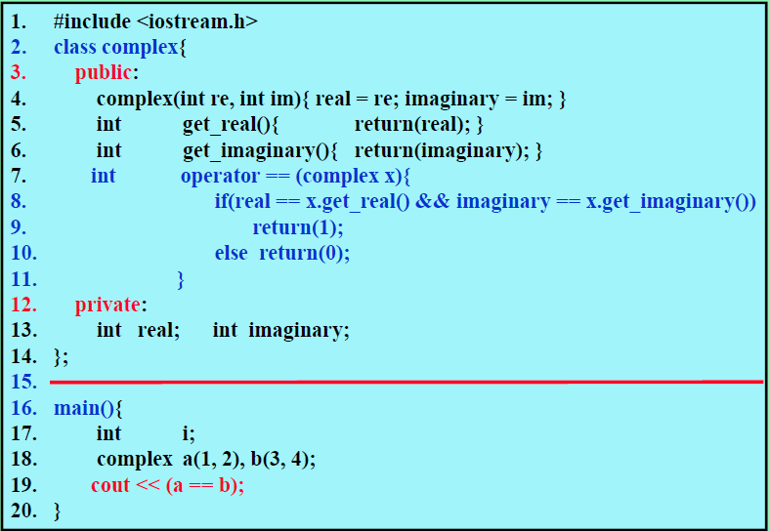
Example: Overload Operator==

Slide 22
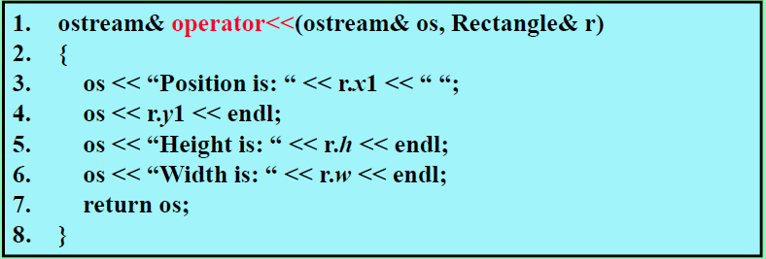
Example: Overload Operator <<
Operator<< accesses private data members of class Rectangle therefore, it must be made a friend of Rectangle.
Note: friend is an exception of data encapsulation, should be avoided in most cases. But sometimes it is necessary as in this case.
Example: cout << r;
→ Position is: 1 3
→ Height is: 6
→ Width is: 6

Slide 23
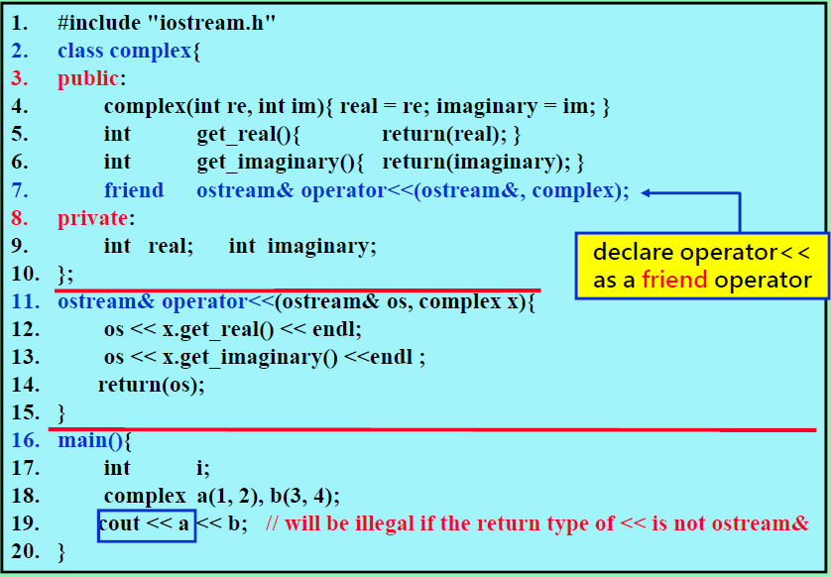
Example: Overload Operator <<

Slide 24
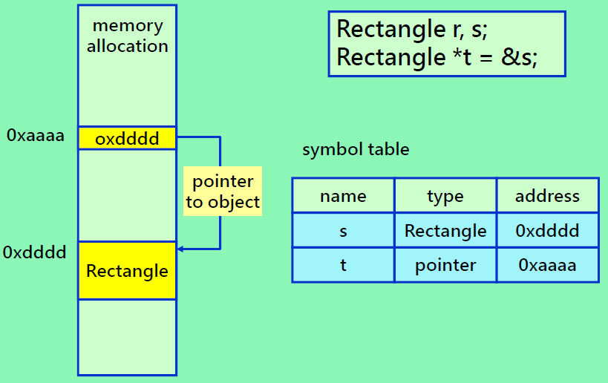
Object vs. Pointer

Slide 25
Example: Object Usage
// In a source file main.cpp
#include <iostream>
#include “Rectangle.h”
main() {
Rectangle r, s； // 物件 r跟 s屬於類別Rectangle
Rectangle *t = &s；// t 是類別物件s的指標
.
.
// 使用 “.” 來存取類別物件的成員。
// 使用 “->“ 透過指標來存取類別物件的成員。
If ( r.GetHigh ( ) * r.GetWidth ( ) > t->GetHeight ( ) * t->GetWidth ( ) )
cout << “r”;
else cout << “s”;
cout << “has the greater area “ << endl;
}

Slide 26
Address and Pointer of Objects
int main()
{
Rectangle a(4, 8);
Rectangle * p = &a.
a.SetHeight(12);
*(&a).SetHeight(12);
(*p).SetHeight(12);
p->SetHeight(12);
return 0;
};
same functionality
"ptr->" is the shorthand of "(*ptr)"

Slide 27
Level of Program Access
class Rectangle
{
public:
Rectangle();
~Rectangle();
int GetHeight();
int GetWidth();
void SetHeight(int i);
void SetWidth(int i);
private:
int h, w;
};
Accessed by | public | protected | private
Same class
Friend class
Derived class
Others
Allowed
Disallowed
Declaring all data members of a class as private → enforce data encapsulation (also known as information hiding)

Slide 28
Miscellaneous Topics
Struct (C++)
Is identical to a class, except that the default level of access is public.
In a class, the default is private
Union
A struct that reserves storage for the largest of its data members
Useful for applications where only one of many possible data items need to be stored at any time
Static class data member
May be thought of as a global variable for its class
A definition of the data member outside the class definition is required

Slide 29
C struct vs. C++ struct
struct in C
Contains only data members, no function members.
Users can directly access struct members from outside the struct (equivalent to “public” level)
struct in C++
Can have both data and function members.
The default program access level is public, but you can specify private level as well.

Slide 30
struct vs. class in C++
struct and class are identical in the C++ language except for the default level of program access
default public for struct
default private for class

Slide 31
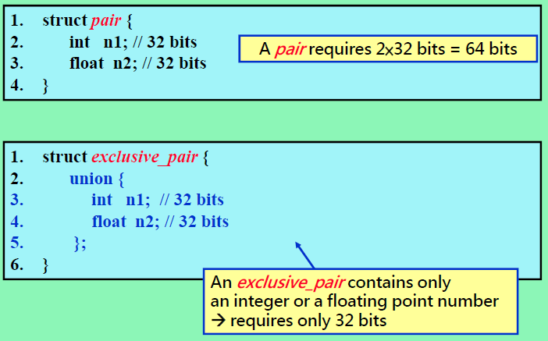
Example of Union

Slide 32
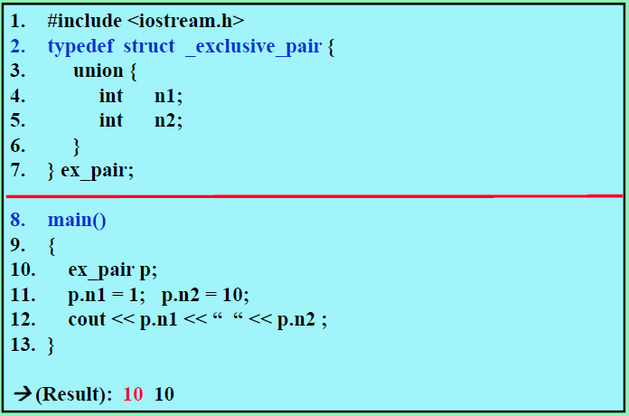
Example of Using Union

Slide 33
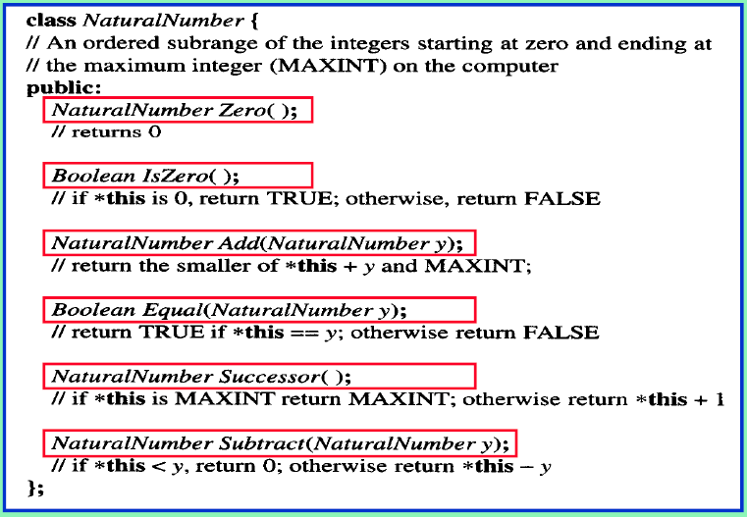
C++ ADT for Natural Numbers

Slide 34
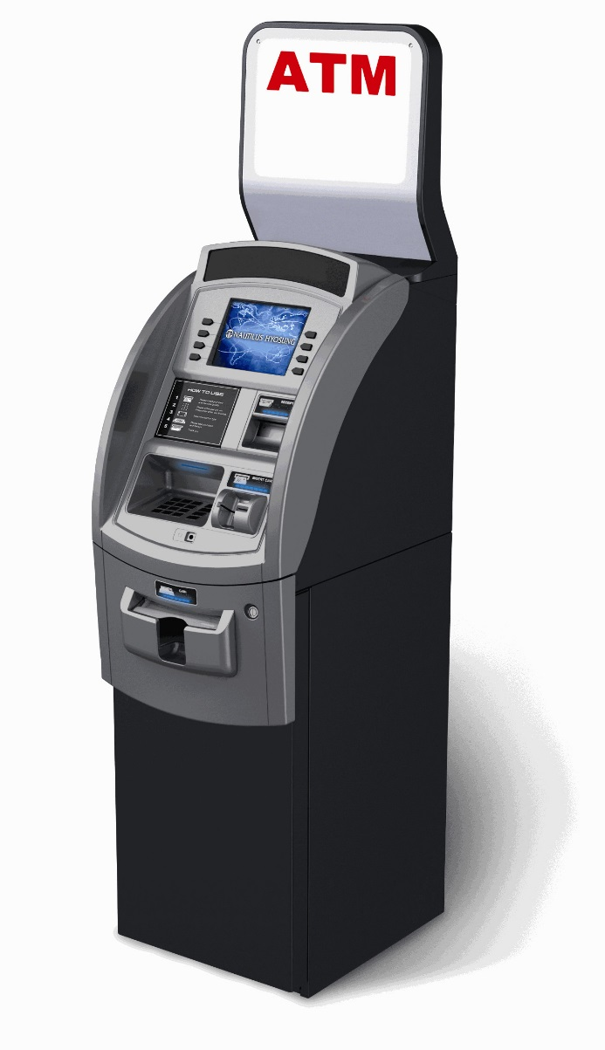


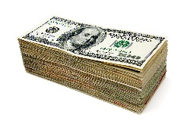
Automatic Teller Machine
Employ is registered as a friend of the machine
Bank employ
GetMoney()
record
protected data members
private data members
Customer
Enforce that a customer cannot accidentally or maliciously access the money and records. (protect both customers and the bank)

Slide 35

Advanced Encapsulation
class Rectangle
{
public:
Rectangle();
~Rectangle();
int GetHeight();
int GetWidth();
void SetHeight(int i);
void SetWidth(int i);
private:
int h, w;
};
Students interested in more aggressive encapsulation
Types, names, and quantity of private data can also be hidden from the class users by using an opaque pointer
Objective: the implementation of the class can be changed without the need to recompile the program using it
Keyword:
Cheshire Cat opaque pointer

Slide 36
Outline
2.1 Abstract Data Types and C++ Class
2.2 The Array as an Abstract Data Type
2.3 The Polynomial Abstract Data Type
2.4 Sparse Matrices
2.5 Representation of Arrays
2.6 The String Abstract Data Type

Slide 37
Traditional (C++) Array
Array Is a set of ordered pair <index, value>
Data structure:
For each index, there is a value associated with that index.
Index is consecutive integers staring at 0
Representation (possible)
Implemented by using a consecutive memory locations
Example:
int list[8]: list[0], …, list[7]
each element list[i] contains an integer
Index 0 1 2 3 4 5 6 7
list

Slide 38
Traditional (C++) Array (cont.)
Array
– Provides two standard operations
Store a value to a given index: list[2] = 5;
Retrieve a value corresponding to a given index: x += list[5];
Store and Retrieve are performed in constant time O(1) (random access)
No index bound checking: list[8] = 10; x += list[9];
Used to implement other abstract data structures (ADTs)
Array is not efficient in operations like:
Insert a value to a given index: needs O(n) time
Remove (delete) a value at a given index: needs O(n) time
A more robust array is needed
– To avoid out-of-bound access
Index 0 1 2 3 4 5 6 7

Slide 39
General Array as an ADT
// 由許多數值對 <index, value> 所乘的集合，其中對於每一個index ∈ IndexSet都有一個float
// 型態的value與其對應。IndexSet是一個有序且有限的一維或多維集合。例如，一維集合
// {0, …, n-1}，二維集合{(0, 0), (0, 1), (0, 2), (1, 0), (1, 1), (1, 2), (2, 0), (1, 0), (1, 1), (1, 2), (2, 0),
// (2, 1), (2, 2)}等。
class GeneralArray {
public:
GeneralArray(int j, RangeList list, float initValue = defaultValue);
// j: dimension
// list: a finite ordered set of dimension j
// initValue: just as its name suggests
float Retrieve(index i);
// Return the float associated with the index i in the array;
// throw an exception if i is not in the index set
void Store(index i, float x);
// Replace the float value corresponding to the index i by x;
// throw an exception if i is not in the index set
};
Default argument

Slide 40
General Array vs. C++'s Raw Array
 | General Array | Raw Array
Index set | more flexible composition | consecutive integers starting at 0
Range checking for indexing | Yes | No
Access methods | Less-intuitive Retrieve() and Store() functions | intuitive [] and = operators
Access speed | Lower (at least due to range checking) | Higher
Is it possible for the general array to also accept [] and = operators ?
A: Yes, by using operator overloading.

Slide 41
Outline
2.1 Abstract Data Types and C++ Class
2.2 The Array as an Abstract Data Type
2.3 The Polynomial Abstract Data Type
2.4 Sparse Matrices
2.5 Representation of Arrays
2.6 The String Abstract Data Type

Slide 42
Ordered List
Ordered (linear) list
One of the simplest and most common data structures
Contains data items organized sequentially as (item1, item2, item3, …, itemn)
Examples:
Days of the week: (MONDAY, TUEDSAY, WEDNESDAY, THURSDAY, FRIDAY, SATURDAYY, SUNDAY)
Values in a deck of cards: (2, 3, 4, 5, 6, 7, 8, 9, 10, Jack, Queen, King, Ace)
Years the US fought in WWII: (1941, 1942, 1943, 1944, 1945)
Years Switzerland fought in WWII: ()
Form of list: (a₁, a₂, a₃, …, a_{n-1}, a_{n})

Slide 43
Operations on Ordered List
Find the length, n, of the list. (0≦i < n)
Read the items from left to right (or right to left).
Retrieve the i-th element, 0≦i < n.
Store a new value into the i-th position , 0≦i < n.
Insert a new element at the position i, , 0≦i < n, causing elements numbered i, i+1, …, n-1 to become numbered i+1, i+2, …, n.
Delete the element at position i, , 0≦i < n, causing elements numbered i+1, …, n-1 to become numbered i, i+1, …, n-2

Slide 44
Ordered List Implementation
Implementing ordered list by array
Sequential mapping -- associate list element a_{i} with array index i
(1)~(2) O
(3)~(4) O (constant time)
(5)~(6) X
Performing operations 5 and 6 requires data movement (to preserve sequential mapping)
Costly
This overhead motivates us to consider nonsequential mapping of order lists in Chapter 4
Linked list

Slide 45
Representation and Manipulation of Polynomials in a Single Variable
Polynomials in a single variable x:
a(x) = 3x² + 2x -4, b(x) = x⁸ -10x⁵ -3x³ +1
A term of polynomial may be represented as a (coefficient, exponent) pair, e.g., (-10,5)
Nonzero term, (sparse: many zero terms)
Degree of polynomial
Sum of polynomial
a(x) + b(x) = Σ(a_{i}+b_{i})x^{i}
Product (multiplication) of polynomial
a(x) × b(x) = Σ(a_{i}x^{i} Σ(b_{j}x^{j} ))

Slide 46
ADT Polynomial
class Polynomial {
// p(x) = a0 x^e0 + … + an x^en
// where ai is nonzero float and ei is non-negative int
public:
Polynomial( );
//construct the polynomial p(x) = 0
Polynomial Add(Polynomial poly);
//return the sum of *this and poly
Polynomial Mult(Polynomial poly);
//return the product of *this and poly
float Eval(float f );
//Evaluate the polynomial *this at f and return the results
int operator!();
// if *this is the zero polynomial, return 1; else return 0;
Coefficient Coef(Exponent e);
// return the coefficient of e in *this
Exponent LeadExp();
// return the largest exponent in *this
};
c++ this pointer

Slide 47
Polynomial Representation
Basic idea
Use an ordered list to store the coefficients and exponents
Three representations
Fixed array of coefficients
Dynamic array of coefficients
Dynamic array of (coefficient, exponent)-tuples

Slide 48

Three Representations
f(x) = 3x⁵ + 7x
9
0
8
0
7
0
6
0
5
5
3
3
4
4
0
0
3
3
0
0
2
2
0
0
1
1
1
7
7
3
5
0
0
0
0
0
7
1
Fixed array of coefficients
Dynamic array of coefficients
Dynamic array of (coefficient, exponent)-tuples
Notes:
2017/3/23 start

Slide 49
Fixed Array of Coefficients
class Polynomial {
public:
//omit
private:
int degree;
float coef[MaxDegree + 1]
};
• Example
– Assume that a is a polynomial class object and n ≦ MaxDegree
– E.g., a_{n}x^{n} + … + a₁x¹ + a₀
– Then, a.degree = n and a.coef[i] = a_{n-i}, 0 ≦i ≦n
• Disadvantage of using static array
– Wasteful in its use of computer memory

Slide 50
Dynamic Array of Coefficients
class Polynomial {
public:
Polynomial(int d);
//omit
private:
int degree;
float * coef;
}
Polynomial::Polynomial(int d){
degree = d;
coef = new float[degree+1];
};
• Advantage
– The size of array can be dynamically decided, leading to a
more efficient memory usage

Slide 51
Dynamic Array of Tuples
For sparse polynomial
E.g., 3x¹⁰⁰ + 7 → as <coef, exp> list → {<3, 100>, <7, 0>} only 2 nonzero terms → 2 element space, 2 space for each element
If using previous dynamic array of coefficient → needs allocate 102 elements space, 1 space for each element
coef
101
7
coef exp
0
1
3
100
.
.
0
7
0
termArray
0
3
coef

Slide 52
Dynamic Array of Tuples
class Polynomial; //forward declaration
class Term{
friend Polynomial;
private:
float coef; //coefficient
int exp; //exponent
};
class Polynomial{
//omit
private:
Term * termArray;
int capacity; //size of termArray
int terms; //number of nonzero terms
}

Slide 53
Polynomial Addition Algorithm
a(x) + b(x) =(10x⁷ + 11x⁵) + (2x⁸ + 3x⁵ + 4x² + 5)
coef exp
coef exp
aPos
bPos
(2) output 10x⁷
10
7
2
8
(1) output 2x⁸
11
5
3
5
(3) output (11+3)x⁵
(3)
a.terms = 2
4
2
(4) output 4x²
5
0
b.terms = 4
(5) output 5
output the remaining terms

Slide 54
Polynomial Addition
Polynomial Polynomial::Add(Polynomial b)
{
Polynomial c; //c.terms = 0
int aPos = 0, bPos = 0;
while ((aPos < terms) && (bPos < b.terms))
if (termArray[aPos].exp == b.termArray[bPos].exp) {
float t = termArray[aPos].coef + b.termArray[bPos].coef;
if (t) c.NewTerm (t, termArray [aPos].exp);
aPos++; bPos++;
}
else if (termArray[aPos].exp < b.termArray[bPos].exp) {
c.NewTerm (b.termArray[bPos].coef, b.termArray[bPos].exp);
bPos++;
}
else {
c.NewTerm (termArray[aPos].coef, termArray[aPos].exp);
aPos++;
}
} //please continue on the next page …
// usage: c = a.Add(b)

Slide 55
Polynomial Addition (Cont'd)
//add in remaining terms of *this
for ( ; aPos < terms ; aPos++)//output the remaining terms
c.NewTerm (termArray[aPos].coef, termArray[aPos].exp);
//add in remaining terms of b
for ( ; bPos < b.terms ; bPos++)//output remaining terms
c.NewTerm (b.termArray[bPos].coef, b.termArray[bPos].exp);
return c;
}

Slide 56
Add New Term into Polynomial
void Polynomial::NewTerm(const float theCoeff, const int theExp)
{// Add a new term to the end of termArray
if (terms == capacity) // termArray (of c) is full
{// double the capacity of termArray
capacity *= 2;
Term *temp = new Term[capacity];
copy(termArray, termArray + terms, temp);
delete [] termArray ; // delete allocated old memory
termArray = temp;
}
termArray [terms].coef = theCoeff;
termArray [terms++].exp = theExp;
}

Slide 57
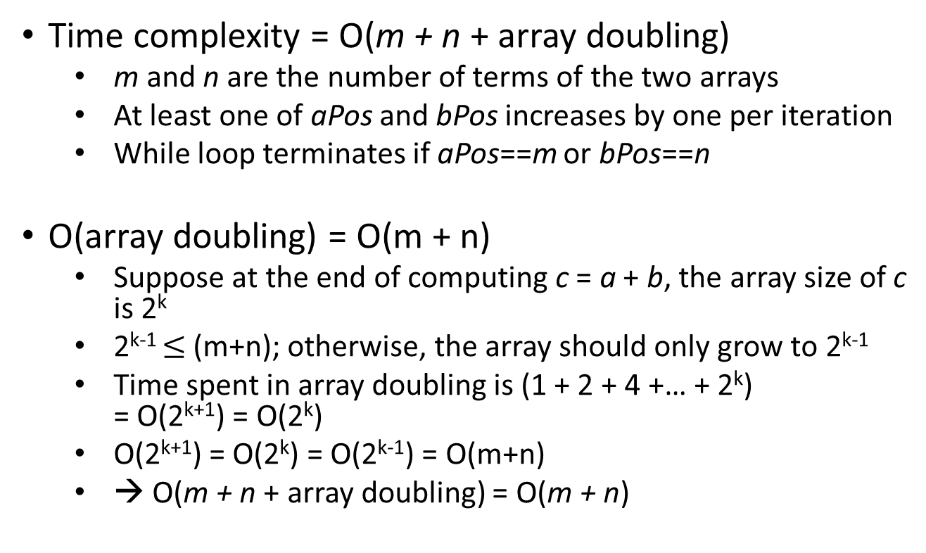
Polynomial Addition (Cont'd)
Time complexity = O(m + n + array doubling)
m and n are the number of terms of the two arrays
At least one of aPos and bPos increases by one per iteration
While loop terminates if aPos==m or bPos==n
O(array doubling) = O(m + n)
Suppose at the end of computing c = a + b, the array size of c is 2^{k}
2^{k-1} $≤$(m+n); otherwise, the array should only grow to 2^{k-1}
Time spent in array doubling is (1 + 2 + 4 +… + 2^{k}) = O(2^{k+1}) = O(2^{k})
O(2^{k+1}) = O(2^{k}) = O(2^{k-1}) = O(m+n)
→ O(m + n + array doubling) = O(m + n)
Notes:
2017/3/23 end

Slide 58
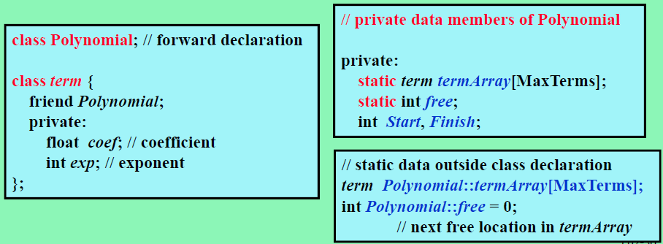
Alternative Dynamic Array of Tuples
Shared single array can be used
All polynomials, (if there are many in the program), will be put together as a shared single array

Slide 59
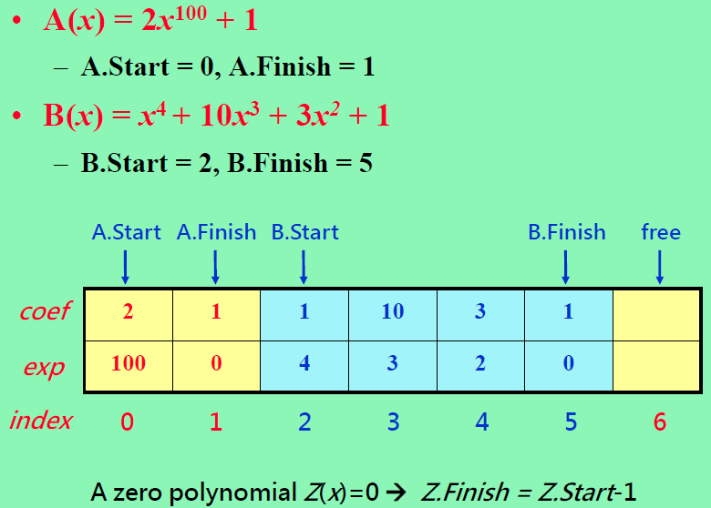
Example: Array for Two Polynomials

Slide 60
Outline
2.1 Abstract Data Types and C++ Class
2.2 The Array as an Abstract Data Type
2.3 The Polynomial Abstract Data Type
2.4 Sparse Matrices
2.5 Representation of Arrays
2.6 The String Abstract Data Type

Slide 61
Matrix
A general matrix consists of m rows and n columns of numbers
An m×n matrix
It is natural to store a matrix in a two dimensional array, say A[m][n] -- space = O(mn)
Dense matrix
Many non-zeros
Sparse matrix
Many zero terms
Sparse matrix is very popular
E.g., the visiting counts of people to places
-27 3 4
6 82 -2
109 -64 11
12 8 9
48 27 47
15 0 0 22 0 15
0 11 3 0 0 0
0 0 0 6 0 0
0 0 0 0 0 0
91 0 0 0 0 0
0 0 28 0 0 0
Use a set of triples <row,col,value>
To represent sparse matrix

Slide 62
Sparse Matrix Example
Sparse: #nonzero elements/#elements is small.
Structured
Diagonal matrix
Only elements along diagonal may be nonzero
n x n matrix → ratio is n/n² = 1/n
Tridiagonal
Only elements on 3 central diagonals may be nonzero
Ratio is (3n-2)/n² = 3/n – 2/n²
Lower triangular (?)
Only elements on or below diagonal may be nonzero
Ratio is n(n+1)(2n²) ~ 0.5
Structured sparse matrices may be mapped into a 1D array so that a mapping function can be used to locate an element quickly

Slide 63
Sparse Matrix Example
Unstructured
Airline flight matrix.
airports are numbered 1 through n
flight(i,j) = list of nonstop flights from airport i to airport j
n = 1000 (say)
n x n array of list pointers => 4 million bytes
total number of nonempty flight lists = 20,000 (say)
need at most 20,000 list pointers => at most 80,000 bytes

Slide 64
Sparse Matrix Example -- Webpage
Web page matrix.
web pages are numbered 1 through n
web(i,j) = number of links from page i to page j
Web analysis.
authority page … page that has many links to it
hub page … links to many authority pages

Slide 65
Web Page Matrix
n = 2 billion (and growing by 1 million a day)
n x n array of ints => 16 * 10¹⁸ bytes (16 * 10⁹ GB)
each page links to 10 (say) other pages on average
on average there are 10 nonzero entries per row
space needed for nonzero elements is approximately 20 billion x 4 bytes = 80 billion bytes (80 GB)

Slide 66
Representation Of Unstructured Sparse Matrices
Single linear list in row-major order.
Scan the nonzero elements of the sparse matrix in row-major order (i.e., scan the rows left to right beginning with row 0 and picking up the nonzero elements)
Each nonzero element is represented by a triple
(row, column, value)
The list of triples is stored in a 1D array (smArray[])
col 0 1 2 3 4 5
row 0
1
2
3
4
5
15 0 0 22 0 15
0 11 3 0 0 0
0 0 0 6 0 0
0 0 0 0 0 0
91 0 0 0 0 0
0 0 28 0 0 0

Slide 67
Single Linear List Example
list = 0 1 2 3 4 5
row 0 0 1 1 3 3
column 2 4 2 3 1 2
Value 3 4 5 7 2 6
0 0 3 0 4
0 0 5 7 0
0 0 0 0 0
0 2 6 0 0

Slide 68
One Linear List Per Row
row0 = [(2, 3), (4,4)]
row1 = [(2,5), (3,7)]
row2 = []
row3 = [(1,2), (2,6)]
0 0 3 0 4
0 0 5 7 0
0 0 0 0 0
0 2 6 0 0

Slide 69
ADT Sparse Matrix
class SparseMatrix
{//三元組，<列，行，值>，的集合，其中列與行為非負整數，
//並且它的組合是唯一的；值也是個整數。
public:
SparseMatrix(int r, int c, int t);
//constructor.
//r is #row, c is #col, t is #non-zero terms
SparseMatrix Transpose( );
//回傳將 *this中每個三元組的行與列交換後的SparseMatrix
SparseMatrix Add(SparseMatrix b);
// 如果 *this和b的維度一樣，那麼就把相對應的項給相加，
// 亦即，具有相同列和行的值會被回傳；否則的話丟出例外。
SparseMatrix Multiply(SparseMatrix b);
// 如果*this中的行數和b中的列數一樣多的話，那麼回傳的矩陣d= *this和b
//（依據d[i][j]=Σ(a[i][k]．b[k][j]，其中d[i][j]是第 (i, j) 個元素）相乘的結果。
// k的範圍從0到*this的行數減1；如果不一樣多的話，那麼就丟出例外。
};

Slide 70
Sparse Matrix Representation
2D array representation wastes not only memory space but also computing time
Dynamic array of (row, col, value) is better
Each triple stands for a non-zero term
Terms are ordered by row and then by columns
 | row | col | value
smArray[0] | 0 | 0 | 15
[1] | 0 | 3 | 22
[2] | 0 | 5 | 15
[3] | 1 | 1 | 11
[4] | 1 | 2 | 3
[5] | 2 | 3 | 6
[6] | 4 | 0 | 91
[7] | 5 | 2 | 28
Eight non-zeros
col
15 0 0 22 0 15
0 11 3 0 0 0
0 0 0 6 0 0
0 0 0 0 0 0
91 0 0 0 0 0
0 0 28 0 0 0
row

Slide 71
Sparse Matrix Representation
class SparseMatrix; //forward declaration
class MatrixTerm {
friend SparseMatrix;
private:
int row, col, value; // a triple representing a term
};
class SparseMatrix
{
public:
SparseMatrix Transpose();
SparseMatrix Multiply(SparseMatrix);
//…
private:
int rows, cols, terms, capacity;
MatrixTerm * smArray;
};
//described in the following slides

Slide 72
Single Linear List
Class SparseMatrix
Array smArray of triples of type MatrixTerm
int row, col, value
int rows, // number of rows
cols, // number of columns
terms, // number of nonzero elements
capacity; // size of smArray
Size of smArray generally not predictable at time of initialization.
Start with some default capacity/size (say 10)
Increase capacity as needed

Slide 73
Approximate Memory Requirements
500 x 500 matrix with 1994 nonzero elements, 4 bytes per element
2D array
500 x 500 x 4 = 1million bytes
Class SparseMatrix
3 x 1994 x 4 + 4 x 4
= 23,944 bytes

Slide 74
Array Resizing
if (newSize < terms) throw “Error”;
MatrixTerm *temp = new MatrixTerm[newSize];
copy(smArray, smArray+terms, temp);
delete [] smArray;
smArray = temp;
capacity = newSize;
To avoid spending too much overall time resizing arrays, we generally set newSize = c * oldSize, where c >0 is some constant.
Quite often, we use c = 2 (array doubling) or c = 1.5.
Now, we can show that the total time spent in resizing is O(s), where s is the maximum number of elements added to smArray.

Slide 75
Transpose a Sparse Matrix
Matrix A
Matrix B = A^{T}
0 0 0 0
0 0 0 2
3 5 0 6
0 7 0 0
4 0 0 0
0 0 3 0 4
0 0 5 7 0
0 0 0 0 0
0 2 6 0 0

Slide 76
Sparse Matrix Transpose
0 0 0 0
0 0 0 2
3 5 0 6
0 7 0 0
4 0 0 0
0 0 3 0 4
0 0 5 7 0
0 0 0 0 0
0 2 6 0 0
Matrix A
Matrix B = A^{T}
row 0 0 1 1 3 3
column 2 4 2 3 1 2
value 3 4 5 7 2 6
1 2 2 2 3 4
3 0 1 3 1 0
2 3 5 6 7 4

Slide 77
Row-by-Row Transpose
We cannot determine the positions in the output array to write to!
 | row | col | value
smArray[0] | 0 | 0 | 15
[1] | 0 | 3 | 22
[2] | 0 | 5 | 15
[3] | 1 | 1 | 11
[4] | 1 | 2 | 3
[5] | 2 | 3 | 6
[6] | 4 | 0 | 91
[7] | 5 | 2 | 28
 | row | col | value
smArray[0] | 0 | 0 | 15
[1]
[2]
[3]
[4]
[5]
[6]
[7]
?
?

Slide 78
Column-by-Column Transpose
Exploit the fact that we can search the input array for terms belonging to a particular column
 | row | col | value
smArray[0] | 0 | 0 | 15
[1] | 0 | 3 | 22
[2] | 0 | 5 | 15
[3] | 1 | 1 | 11
[4] | 1 | 2 | 3
[5] | 2 | 3 | 6
[6] | 4 | 0 | 91
[7] | 5 | 2 | 28
 | row | col | value
smArray[0] | 0 | 0 | 15
[1] | 0 | 4 | 91
[2] | 1 | 1 | 11
[3] | 2 | 1 | 3
[4] | 2 | 5 | 28
[5] | 3 | 0 | 22
[6] | 3 | 0 | 6
[7] | 5 | 2 | 15

Slide 79
Transpose a Sparse Matrix
SparseMatrix SparseMatrix::Transpose( )
{
SparseMatrix b(cols , rows , terms);
if (terms > 0){
int currentB = 0;
for (int c = 0 ; c < cols ; c++)
for (int i = 0 ; i < terms ; i++)
if (smArray[i].col = = c) {
b.smArray[currentB].row = c;
b.smArray[currentB].col = smArray[i].row;
b.smArray[currentB].value =
smArray[i].value;
currentB++;
}
} //end of if(terms >0)
return b;
}
time complexity:
O(cols ‧ terms)
Space complexity: O(1)

Slide 80
Transpose a Sparse Matrix (Cont'd)
We have shown an O(cols ‧ terms)-time algorithm for Sparse Matrix Transpose
Transpose can be done in O(cols ‧ rows) = O(terms) time if the matrix is in traditional 2D array representation
Is there also an O(terms)-time algorithm for Sparse Matrix Transpose?
for (int y = 0 ; y < cols ; y++)
for (int x = 0 ; x < rows; x++)
b[y][x] = a[x][y];

Slide 81
Principles In Fast Transpose
Look Before You Leap
A Stitch Beforehand Saves Nine
Quick pre-computation of certain information pays back often
row | col | value
0 | 0 | 15
0 | 3 | 22
0 | 5 | 15
1 | 1 | 11
1 | 2 | 3
2 | 3 | 6
4 | 0 | 91
5 | 2 | 28
row | col | value
0 | 0 | 15
0 | 4 | 91
1 | 1 | 11
2 | 1 | 3
2 | 5 | 28
3 | 0 | 22
3 | 2 | 6
5 | 0 | 15

Slide 82
Strategy
Scan the array for a constant number of passes (e.g., 3 passes)
Each pass is O(terms), O(cols), and O(terms), respectively
So the time for all 3 passes is O(cols+terms)
Early pass collects information to assist the following passes
Specifically, determine the positions in the output array to write to
Pass 1: find out # of items in each row of new smArray
Pass 2: find out starting index of each row in new smArray
Pass 3: move item from old smArray to new smArray accordingly

Slide 83
Issue of Row-by-Row Transpose
item
item
row | col | value
0 | 0 | 15
0 | 3 | 22
0 | 5 | 15
1 | 1 | 11
1 | 2 | 3
2 | 3 | 6
4 | 0 | 91
5 | 2 | 28
row | col | value
0 | 0 | 15
(0, 0)
(0, 0)
(0, 3)
(3, 0)
?
Since rows 0, 1, 2 of the transposed haven't finish yet, we do not know where row 3 begins!

Slide 84
Issue of Row-by-Row Transpose
item
item
row | col | value
0 | 0 | 15
0 | 3 | 22
0 | 5 | 15
1 | 1 | 11
1 | 2 | 3
2 | 3 | 6
4 | 0 | 91
5 | 2 | 28
row | col | value
0 | 0 | 15
(0, 0)
(0, 0)
(0, 3)
(3, 0)
?
Since rows 0, 1, 2 of the transposed haven't finish yet, we do not know where row 3 begins!
Scan old col→new row 0:2, 1:1, 2:2, 3:2,4:0, 5:1
index : [0] [1] [2] [3] [4] [5]
RowSize = 2 1 2 2 0 1

Slide 85
Fast Transpose Strategy
row | col | value
0 | 0 | 15
0 | 3 | 22
0 | 5 | 15
1 | 1 | 11
1 | 2 | 3
2 | 3 | 6
4 | 0 | 91
5 | 2 | 28
row | col | value
0 | 0 | 15
3 | 0 | 22
(0, 0)
(0, 0)
(0, 3)
(3, 0)
After scanning to find element # of each transpose row, we can determine the start index of each row!
index : [0] [1] [2] [3] [4] [5]
RowSize = 2 1 2 2 0 1
RowStart = 0 2 3 5 7 7

Slide 86
Fast Transpose
SparseMatrix SparseMatrix::FastTranspose( )
{
SparseMatrix b(cols , rows , terms);
if (terms > 0) {
int *rowSize = new int[cols];
int *rowStart = new int[cols];
// calculate the row size of the new matrix
fill(rowSize, rowSize + cols, 0);
for (int i = 0 ; i < terms ; i ++)
rowSize[smArray[i].col]++;
// calculate the starting array index of each row
// of the new matrix
rowStart[0] = 0;
for (int i = 1 ; i < cols ; i++)
rowStart[i] = rowStart[i-1] + rowSize[i-1];
1st pass, O(terms)
2nd pass, O(cols)

Slide 87
FastTranspose
for (int i = 0 ; i < terms ; i++){
int j = rowStart[smArray[i].col];
b.smArray[j].row= smArray[i].col;
b.smArray[j].col = smArray[i].row;
b.smArray[j].value = smArray[i].value;
rowStart[smArray[i].col]++;
} // end of for
delete [] rowSize;
delete [] rowStart;
} // end of if
return b;
}
3rd pass, O(terms)
Space complexity: O(cols)

Slide 88

Matrix Multiplication
Definition: Given A, mxn and B, nxp matrices, C = AxB is a mxp matrix
1 2 0
3 0 0
3 0 6
1 2 3
0 5 0
0 0 7
a b c
d e f
g h i
×
=
A
B
C
Direct computation would require time complexity of O(mnp)
What if sparse matrix multiplication?

Slide 89
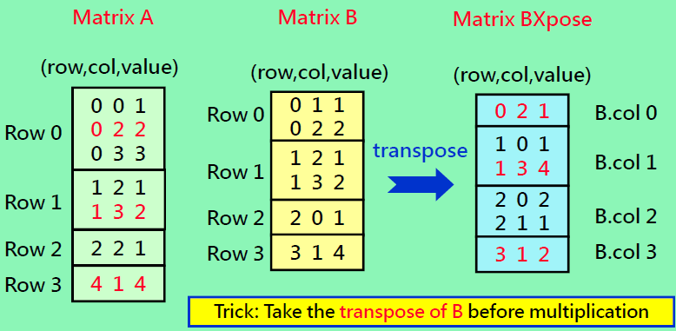
Sparse Matrix Multiplication
A_{5x4}
B_{4x4}
Process A.row i and B.col j to get a term C.row i, col j

Slide 90
Multiply Two Arrays
CurrRowIndex
CurrColIndex
CurrRowA
×
CurrColB
Row i
2 terms
Col p
4 terms
Row j
5 terms
Col q
2 terms
5 terms
4 terms
Col r
Row k
Array A
Array B

Slide 91
Multiply Two Matrixes
// C = A * B
// some preparations
for (all terms in A) {
for (all terms in B) {
if (end of the curr row in A) {
store the sum and reset the sum;
rewind to the first term of the curr row;
skip the remaining terms of the curr col;
} else if (end of the curr col in B) {
store the sum and reset the sum;
rewind to the first term of the curr row;
} else {
accumulate the product of two terms if possible;
}
}
CurrRowA = the next row of matrix A;
skip the remain terms of the curr row;
}

Slide 92
Inner Product of RowA and ColB
Row
Col
a
col 0
row 1
c
(1)
(2)
2 terms
4 terms
(3)
b
col 3
row 3
d
(3)
col 4
e
Skip terms in the col
(5)
f
(6)
(4) output (b×d)

Slide 93
Store the Dot Product Sum
void SparseMatrix::StoreSum(const int sum, const int r, const int c)
{
if (sum != 0) {
if (terms = = capacity)
ChangeSize1D(2*capacity);
smArray[terms].row = r;
smArray[terms].col = c;
smArray[terms++].value = sum;
}
}

Slide 94
Change Array Size
void ChangeSize1D(const int newSize)
{ // change the array size to newSize
if (newSize < terms)
throw “New size must be >= number of terms”;
MatrixTerm *temp = new MatrixTerm[newSize];
// new array
copy(smArray, smArray + terms, temp);
delete [] smArray;
smArray = temp;
// make smArray point to the newly created array
capacity = newSize;
}

Slide 95
Sparse Matrix Multiplication
Transposing matrix B eases sparse matrix handling
Non-zeros terms of a row are stored together
1 2 0
3 0 0
3 0 6
1 2 3
0 5 0
0 0 7
a b c
d e f
g h i
×
=
A
B
C
1 2 0
3 0 0
3 0 6
1 0 0
2 5 0
3 0 7
a b c
d e f
g h i
×
=
A
B^{T}
C

Slide 96
Multiply
SparseMatrix c = a.Multiply(b);
SparseMatrix SparseMatrix::Multiply(SparseMatrix b)
{
if (cols != b.rows) // error handling
throw “Incompatible matrices”;
SparseMatrix bXpose = b.FastTranspose( ); // transpose b
SparseMatrix d (rows, b.cols, 0); // create the output matrix d
int currRowIndex = 0,
currRowBegin = 0,
currRowA = smArray[0].row;
// introduce dummy terms for handling boundary condition
if (terms == capacity)
ChangeSize1D(terms + 1);
// introduce dummy terms for handling boundary condition
bXpose.ChangeSize1D(bXpose.terms + 1);
smArray[terms].row = rows;
bXpose.smArray[b.terms].row = b.cols;
bXpose.smArray[b.terms].cols = -1;

Slide 97
Multiply (Cont'd)
int sum = 0;
while (currRowIndex < terms) { // check currRowA is valid
int currColB = bXpose.smArray[0].row;
int currColIndex = 0;
while (currColIndex <= b.terms){ // process B matrix term by term
if (smArray[currRowIndex].row != currRowA) { // row end
d.StoreSum(sum,currRowA,currColB); // store the sum
sum = 0; // reset the sum
currRowIndex = currRowBegin; // rewind the row
while (bXpose.smArray[currColIndex].row == currColB)
currColIndex++; // skip terms in the curr col
currColB = bXpose.smArray[currColIndex].row; // next col
} else if (bXpose.smArray[currColIndex].row != currColB) {
// col end
d.StoreSum(sum,currRowA,currColB); // output the sum
sum = 0; // reset the sum
currRowIndex = currRowBegin; rewind the row
currColB = bXpose.smArray[currColIndex].row; // next col
}

Slide 98
Multiply (Cont'd)
else {
if (smArray[currRowIndex].col <
bXpose.smArray[currColIndex].col)
currRowIndex++;
else if (smArray[currRowIndex].col ==
bXpose.smArray[currColIndex].col) {
sum += smArray[currRowIndex].value *
bXpose.smArray[currColIndex].value;
currRowIndex++;
currColIndex++;
}
else
currColIndex++;
} // end of if-elseif-else
} // end of the inner while (currColIndex <= b.terms)
while (smArray[currRowIndex].row == currRowA)
currRowIndex++; // skip terms in the curr row
currRowBegin = currRowIndex; //next row
currRowA = smArray[currRowIndex].rows; //next row
} // end of the outer while (currRowIndex < terms)
return d;
}

Slide 99
Outline
2.1 Abstract Data Types and C++ Class
2.2 The Array as an Abstract Data Type
2.3 The Polynomial Abstract Data Type
2.4 Sparse Matrices
2.5 Representation of Arrays
2.6 The String Abstract Data Type

Slide 100
N-Dimensional Array
Example (C/C++)
float hour[60];
int day[24][60];
char year[365][24][60];
T a[u₁][u₂][u₃], …, [u_{n}];
Memory comprises a linear sequence of bytes
Array representation and access
Computed index
C/C++'s array
Common practice uses "T" to denote a type

Slide 101
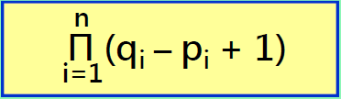
Multi-dimensional Array
An n-dimensional general array
Is usually implemented as a one-dimensional array
A mapping mechanism is needed
Assumption of A[u₁][u₂]…[u_{n}]
First index range: [p₁ .. q₁] (# of elements = q₁ - p₁ +1)
Second index range: [p₂ .. q₂]
…
n-th index range: [p_{n} .. q_{n}]
The total number of elements in this n-dimensional array is
In C/C++ multidimension array, index p_{i} starts from 0

Slide 102
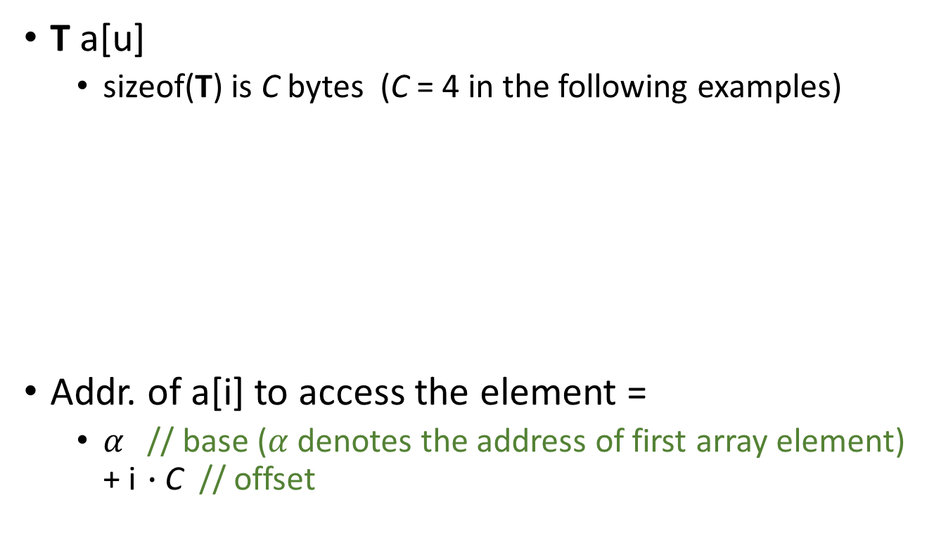
1-D Array
T a[u]
sizeof(T) is C bytes (C = 4 in the following examples)
Addr. of a[i] to access the element =
$α$// base ($α$denotes the address of first array element) + i$∙$C// offset
u* sizeof(T)
memory
…
0th
1st
2nd
i^{th}
u-1th
a[0]
a[1]
a[i]
a[u-1]

Slide 103
2-D Array
T a[u₁][u₂] (a total of u₁*u₂ elements)
Row Major Order
Column Major Order
u₁ groups
u₂ groups
0th
u₁-1th
0th
u₂-1th
0th
1st
2nd
u₂-1th
0th
1st
u₁-1th
each group further contains u₂ elements (1 row)
each group further contains u₁ elements (1 column)

Slide 104
2-D Array
T a[u₁][u₂]
Row Major Order
u₁ groups
Elements are placed in memory in
lexicographic order (字典順序)
also known as numerical order
0th
0th
1st
2nd
u₂-1th
Row major order = numerical order = lexicographic order
u₂ element
a[0][0]
a[0][1]
…
…
a[0][u₂-1]

Slide 105
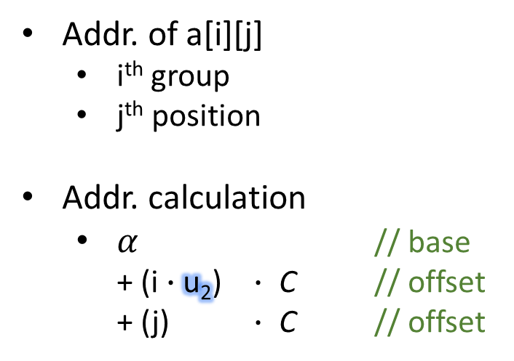
2-D Array
T a[u₁][u₂]
Addr. of a[i][j]
i^{th} group
j^{th} position
Addr. calculation
$α$// base + (i$∙$u₂) $∙$C // offset + (j) $∙$C // offset
Row Major Order
u₁ groups
0th
0th
1st
2nd
u₂-1th
a[i][j] → (&a[0] + (i*u2+j)*C)
u₂ element
a[0][0]
a[0][1]
…
…
a[0][u₂-1]

Slide 106
3-D Array
T a[u₁][u₂][u₃] (a total of u₁*u₂*u₃ elements)
Row Major Order
u₁ groups
0th
u₁-1th
u₂ groups
0th
u₂₋1th
0th
1st
2nd
u₃-1th
u₃ element

Slide 107

3-D Array
T a[u₁][u₂][u₃]
a[i][j][k]
i^{th} level-1 group
j^{th} level-2 group
k^{th} element
Addr. of a[i][j][k]
$α$ // base + (i$∙$u₂u₃) $∙$C // offset + (j$∙$u₃) $∙$C // offset + (k) $∙$C// offset
Row Major Order
u₁ level-1 groups
0th
u₁-1th
u₂ level-2 groups
0th
u₂-1th
0th
1st
2nd
u₃-1th
u₃ element

Slide 108
3-D Array (Textbook's Illustration)
Emphasize what "row-major" means
But in fact, memory is linear instead of cubic
u₁ matrices in a cube
u₂ rows in a matrix
u₃ elements in a row
0th
1st
2nd

Slide 109

4-D Array
T a[u₁][u₂][u₃][u₄]
a[i][j][k][m]
m^{th}level-1 group
i^{th} level-2 group
j^{th} level-3 group
k^{th} element
Addr. of a[i][j][k][m]
$α$// base + (i$∙$u₂u₃u₄) $∙$C // offset + (j $∙$u₃u₄) $∙$C // offset + (k $∙$u₄) $∙$C // offset + (m) $∙$C // offset
Row Major Order
u₁ level-1 groups
0th
u₁-1th
u₂ level-2 groups
0th
u₂-1th
u₃ level-3 groups
0th
u₃-1th
u₄ elements
0th
1st
2nd
u₄-1th

Slide 110
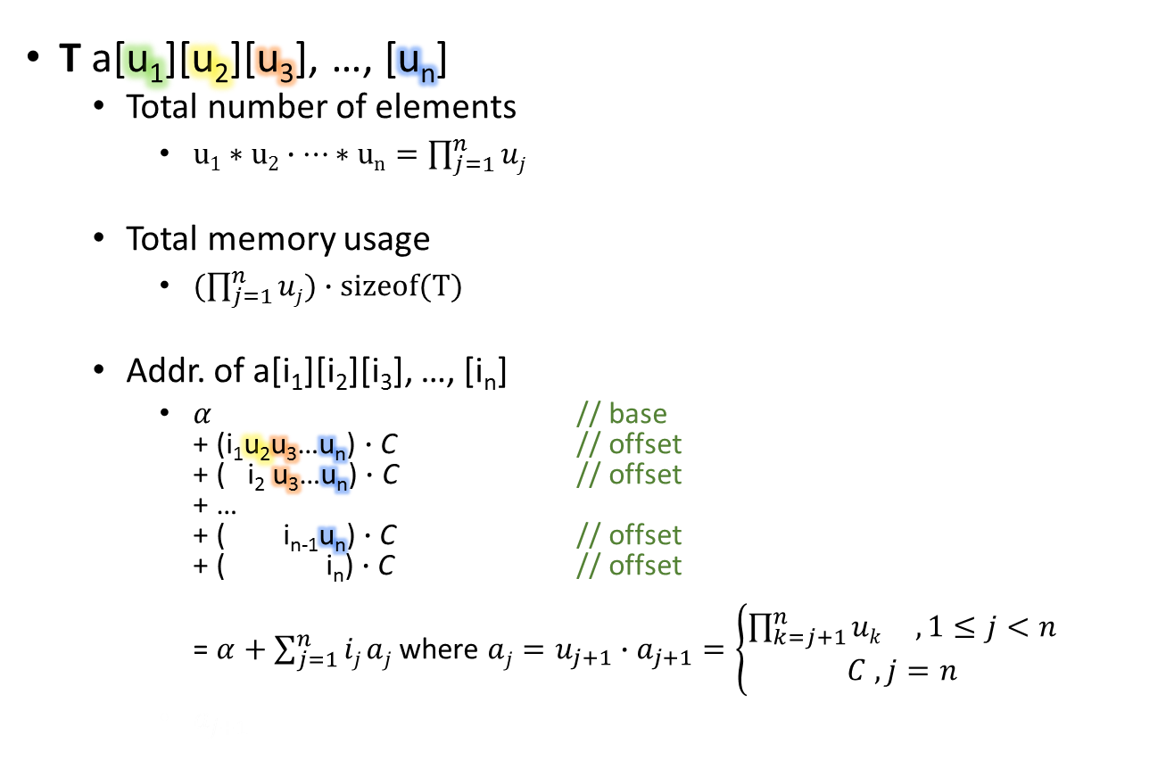
N-Dimension Array
T a[u₁][u₂][u₃], …, [u_{n}]
Total number of elements
$u1∗u2∙…∗un=\prod_{j=1}^{n}{uj}$
Total memory usage
$(\prod_{j=1}^{n}{uj})∙sizeof(T)$
Addr. of a[i₁][i₂][i₃], …, [i_{n}]
$α$// base + (i₁u₂u₃…u_{n}) $∙$C // offset + ( i₂u₃…u_{n}) $∙$C // offset + … + ( i_{n-1}u_{n}) $∙$C // offset + ( i_{n}) $∙$C // offset = $α+\sum_{j=1}^{n}{ij aj}$ where $aj=u_{j+1}∙a_{j+1}=\left\{\begin{matrix}\prod_{k=j+1}^{n}{uk } ,1≤j<n \\ C , j=n\end{matrix}\right.$
$a_{j+1}$

Slide 111
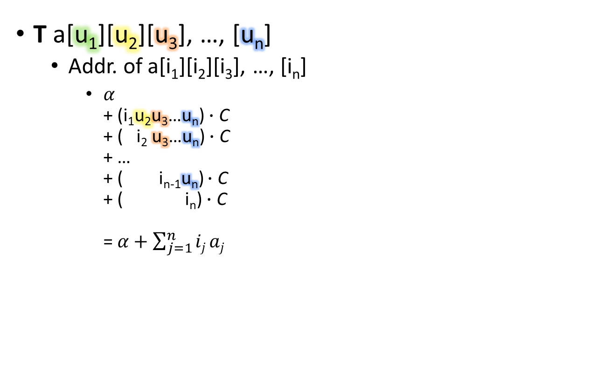
N-Dimension Array
T a[u₁][u₂][u₃], …, [u_{n}]
Addr. of a[i₁][i₂][i₃], …, [i_{n}]
$α$ + (i₁u₂u₃…u_{n}) $∙$C + ( i₂u₃…u_{n}) $∙$C + … + ( i_{n-1}u_{n}) $∙$C + ( i_{n}) $∙$C = $α+\sum_{j=1}^{n}{ij aj}$
Observations
u₂u₃…u_{n}, i₁, i₂, …, i_{n}, 𝛼, and C are musts, but u₁ is not required

Slide 112
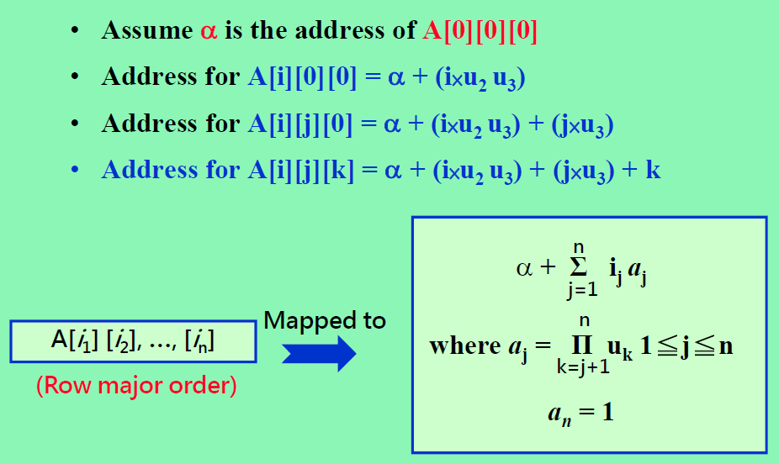
Address Mapping Formula

Slide 113
C/C++'s Arrays
Representation and access methods for the following two array types
Statically-allocated arrays
T a[u₁][u₂][u₃];
a[i][j][k] (0≦i<u_{1,} 0≦j<u_{2,} 0≦k<u₃ )
Computed index: *(a+sizeof(T)*(i* u₂* u₃ +j* u₃ +k))
Dynamically-allocated arrays
T* ap = new T[];
ap[i* u₂* u₃ +j* u₃ +k] =100;
Pointer arithmetic *(ap+(i* u₂* u₃ +j* u₃ +k))

Slide 114
Statically-Allocated Arrays
int main()
{
float num[12][31][24];
cout << sizeof(num[2][19][14]) << endl;
cout << sizeof(num[2][19]) << endl;
cout << sizeof(num[2]) << endl;
cout << sizeof(num) << endl;
return 0;
}
4
96
2976
35712
Some people refer to this design as array of arrays

Slide 115
Static Array as an Argument
int main()
{
float num[12][31][24];
clearAll(num);
return 0;
}
Syntax for array arguments
Syntax for array arguments
Specifying the size of the first dimension is optional
Specifying the sizes of the other dimensions is a must
void clearAll(float a[][31][24])
{
for(int m=0; m<12; m++)
for(int d=0; d<31; d++)
for(int h=0; h<24; h++)
a[m][d][h] = 0;
return;
}
Address calculation
u₁ is optional
u₂…u_{n} are musts
Array arguments allow side effects: assignments to the array are visible to the calling function.

Slide 116
Static Array as an Argument
int main()
{
float num[12][31][24];
// a specific month or day is a sub-array
clearMonth(num[2]); clearDay(num[5][19]); return 0;
}
void clearMonth (float a[][24])
{
for(int d=0; d<31; d++)
for(int h=0; h<24; h++)
a[d][h] = 0;
return;
}
void clearDay (float a[])
{
for(int h=0; h<24; h++)
a[h] = 0;
return;
}

Slide 117
Outline
2.1 Abstract Data Types and C++ Class
2.2 The Array as an Abstract Data Type
2.3 The Polynomial Abstract Data Type
2.4 Sparse Matrices
2.5 Representation of Arrays
2.6 The String Abstract Data Type

Slide 118
ADT String
class String
{
public:
String(char *init, int m);
// constructor using input string init of length m
bool operator == (String t);//equality test
bool operator!( ); // empty test, true or false
int Length( );//get the number of characters of *this
String Concat(String t);
// concatenation with another string t
String Substr(int i, int j); // generate a substring
int Find(String pat);
// Return an index i such that pat matches the substring
// of the object begins at position i. Return -1 if pat
// is empty or not a substring of the object
}

Slide 119
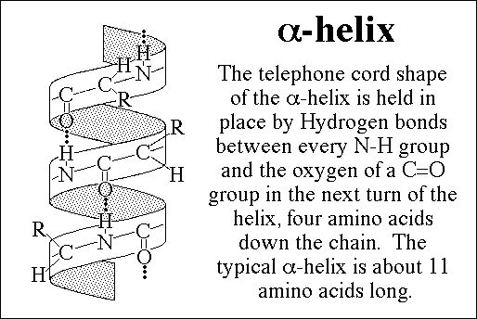
String Matching
Problem: finding if a pattern is in another string
Important class of algorithm
Applications
Search engines
Natural language processing
Bioinformatics
Identification of α-helices in protein sequences
Matching profiles or probabilistic sequences

Slide 120
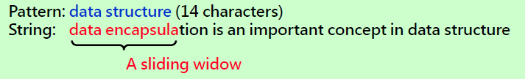

Simple String Pattern Matching
Comparing the sub-string within the window with the pattern
→ A mismatch at the sixth character
Slide the window forward by one step
→ A mismatch again !
Continue to slide the window forward …

Slide 121
Exhaustive String Matching
int String::Find(String pat)
{
for (int start=0; start <= Length( )-pat.Length();start ++)
{
int j;
for(j=0;j<pat.Length( ) && str[start+j]==pat.str[j]; j++);
if (j == pat.Length( ))
return start;
}
return -1 ;
}
n
String
Outer loop iterates O(n) times
Inner loop iterates O(m) times
Total time complexity is O(nm) times
pat
pat
… …
… …
… …
pat
m

Slide 122
Introduce Heuristics into Find()
String s, pattern pat, s.Find(pat);
For each position start of s considered in Find(), we may check for a match of the last character at position (start + lengthP – 1) of s before examining characters 0 through lengthP – 2 of pat for a match.
The asymptotic complexity is still O(lengthP * lengthS)
String s
pat

Slide 123
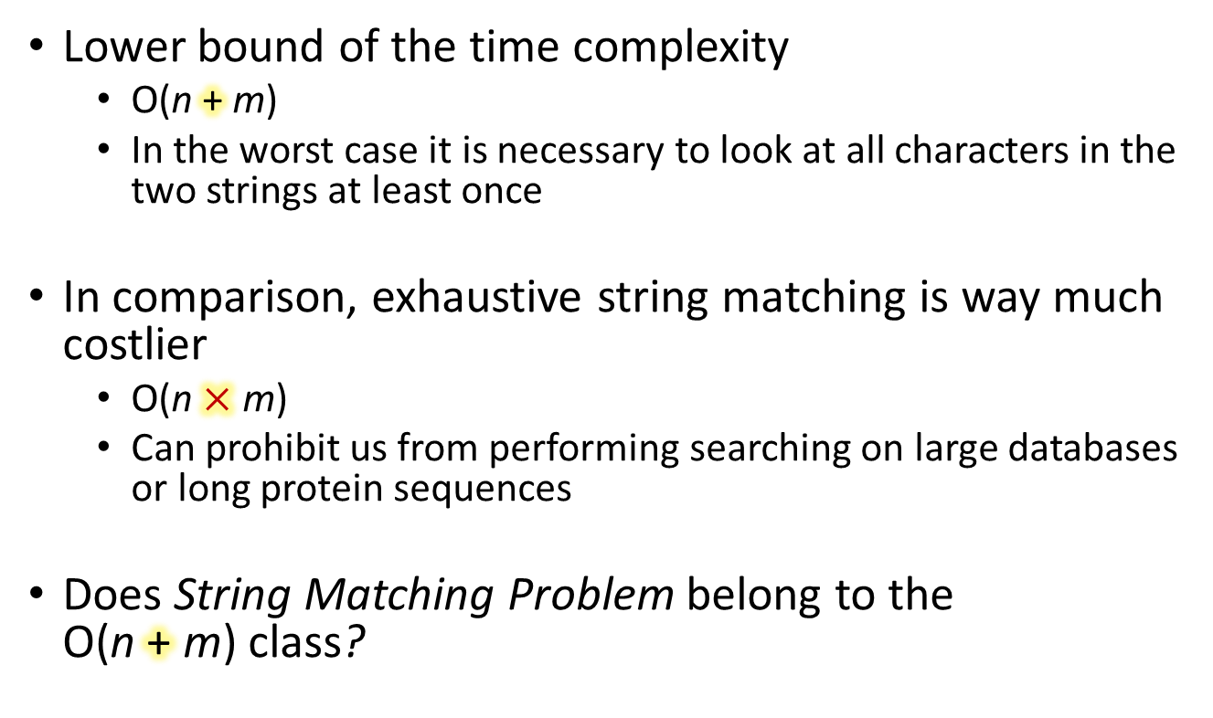
String Matching
Lower bound of the time complexity
O(n+m)
In the worst case it is necessary to look at all characters in the two strings at least once
In comparison, exhaustive string matching is way much costlier
O(n$×$m)
Can prohibit us from performing searching on large databases or long protein sequences
Does String Matching Problem belong to the O(n+m) class?

Slide 124
Knuth-Morris-Pratt (KMP) Algorithm
O(m + n)-time
Strategy to achieve linear time complexity
Prevent the algorithm from moving backwards in the string (the sliding window only moves forward one step at a time)
Exploit the knowledge of a mismatch to determine where we should resume the search
Exhaustive
KMP
String
String
pat
pat
pat
pat
pat

Slide 125
KMP Example
j= 012345
Searching a string s for a pattern pat = "abcabc"
Since the string pat consists of 6 characters, we need to handle a total of 7 cases
No matched characters yet (pat[0] is a mismatch)
Last match at pat[0] (pat[1] is a mismatch)
Last match at pat[1] (pat[2] ….
Last match at pat[2] (pat[3] ….
Last match at pat[3] (pat[4] ….
Last match at pat[4] (pat[5] ….
Last match at pat[5] (i.e, a matched pattern is found)

Slide 126
KMP Example
Case 1: No matched characters yet (j=0)
s_{i}
s_{i+1}
String
x
Pat
a
b
c
a
b
c
If X is not a, matching resume by sliding pat 1 step and resume matching pat[0] with new s_{i+1}
Action
a
b
c
a
b
c
resume at pat [0]
In this case, KMP behaves the same as exhaustive search

Slide 127
KMP Example
Case 2: Last match at pat[0] (j=1)
s_{i-1}
s_{i}
String
a
x
Pat
a
b
c
a
b
c
X is not b but could be a
So matching resume by comparing s_{i} and p[0]
Action
a
b
c
a
b
c
resume at pat [0]
In this case, KMP behaves the same as exhaustive search

Slide 128
KMP Example
Case 3: Last match at pat[1] (j=2)
s_{i-2}
s_{i-1}
s_{i}
String
a
b
x
Pat
a
b
c
a
b
c
X is not c but could be a and previous is b not a, so start matching pat[0] and s_{i}
Action
a
b
c
a
b
c
resume at pat [0]
In this case, KMP is better than exhaustive search

Slide 129
KMP Example
Case 4: Last match at pat[2] (j=3)
s_{i-3}
s_{i-2}
s_{i-1}
s_{i}
String
a
b
c
x
X is not a and previous is b,c not a, and due to pattern of pat, so start matching pat[0] and s_{i}
Pat
a
b
c
a
b
c
Action
a
b
c
a
b
c
resume at pat [0]
In this case, KMP is better than exhaustive search

Slide 130
KMP Example
Case 5: Last match at pat[3] (j=4)
s_{i-4}
s_{i}
String
a
b
c
a
x
Pat
a
b
c
a
b
c
Action
a
b
c
a
b
c
resume at pat [1]
In this case, KMP is better than exhaustive search

Slide 131
KMP Example
Case 6: Last match at pat[4] (j=5)
String
a
b
c
a
b
x
Pat
a
b
c
a
b
c
Action
a
b
c
a
b
c
resume at pat [2]
In this case, KMP is better than exhaustive search

Slide 132
KMP Example
Case 7: Last match at pat[5] (i.e., a match is found)
String
a
b
c
a
b
c
Pat
a
b
c
a
b
c
Action
a
b
c
a
b
c
resume at pat [3]
In this case, KMP is better than exhaustive search

Slide 133
Resume Point Summary
s_{i}
String s
a
b
c
a
b
c
0
1
2
3
4
5
Pat
a
b
c
a
b
c
Resume pt.
0
0
0
1
2
3
Thus by knowing the characters in the pattern and the position in the pattern where a mismatch occurs with a character in s, we can determine where in the pattern to continue the search for a match without moving backwards in s.

Slide 134
Failure function
Definition
If p = p₀p₁..p_{n-1} is a pattern then its failure function f(j) is defined as
largest k<j such that (p_{j-k}p_{j-k+1}…p_{j}) = (p₀p₁…p_{k}) if such
a k≧0 exists
(2) otherwise f(j) = -1;
Example:
j | 0 | 1 | 2 | 3 | 4 | 5
pat | a | b | c | a | b | c
f(j) | -1 | -1 | -1 | 0 | 1 | 2
j | 0 | 1 | 2 | 3 | 4 | 5 | 6 | 7 | 8 | 9
pat | a | b | c | a | b | c | a | c | a | b
f(j) | -1 | -1 | -1 | 0 | 1 | 2 | 3 | -1 | 0 | 1

Slide 135
Usage of Failure Function
Scenario:
string s = s₀s₁…..s_{m-1}, pat = p₀p₁…p_{n-1}.
We are matching s_{i} with a partial match of first j characters of pat
Rule of pattern matching:
If a partial match is found such that s_{i-j}..s_{i-1} = p₀..p_{j-1}, and s_{i} ≠ p_{j}, then matching may be resumed by comparing s_{i} and p_{f(j-1)+1} if j ≠ 0.
If j = 0, indicating no partial match so far, then we may continue by comparing s_{i+1} and p₀.
s_{i}
p_{j}
p_{f(j-1)+1}

Slide 136
Example of Using Failure Function
s₅
a | b | c | a | b | y | a | b | y | a | c | a | b | c
a | b | c | a | b | c | a | c | a | b
p₅
p₅ → j=5, f(j-1) + 1 = 2
→ compare s₅ with p₂
j | 0 | 1 | 2 | 3 | 4 | 5 | 6 | 7 | 8 | 9
F(j) | -1 | -1 | -1 | 0 | 1 | 2 | 3 | -1 | 0 | 1
res | 0 | 0 | 0 | 0 | 1 | 2 | 3 | 4 | 0 | 1
Next step: comparing s₅ with p₂
Now, the window of String being compared starts from s₃

Slide 137
KMP Example Summary
No matched characters
Advance the searching point in the string
Resume at pat[0]
Others
Keep the searching point in the string
Table look-up to determine the pattern resume point
Table contents depend on the pattern (instead of the string)
Pattern:
a
b
c
a
b
c
Resume point vs last match:
0
0
0
1
2
3
Textbook refers to an equivalent table as failure function
-1
-1
-1
0
1
2

Slide 138
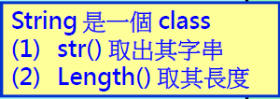
Fast Find Using the KMP Algorithm
int String::FastFind(String pat)
{
int posP = 0, posS = 0;
int lengthP = pat.Length(), lengthS = Length();
while((posP < lengthP) && (posS < lengthS)){
if (pat.str[posP] == str[posS]) {
posP++;
posS++;
}else{
if (posP == 0)
posS++;
else
posP = pat.f[posP -1] + 1;
}
}
if (posP < lengthP)
return -1;
else // Textbook stops pattern matching once a match is found
return posS-lengthP;
}
posS
abcabyabyacab
abcabcacab
posP
time = O(lengthS)

Slide 139
Recap KMP
START
posS = 0; posP = 0;
character match?
Y
N
posP == 0
posS ++;
posP ++;
posS ++;
posP = one value between 0 and posP -1
posS >= N or posP >= M
N
Y
END

Slide 140
Recap KMP
START
posS = 0; posP = 0;
character match?
O(N) times
N
Y
O(N) times
posP == 0
posS ++;
posP ++;
posS ++;
posP = one value between 0 and posP -1
posS >= N or posP >= M
N
Y
END

Slide 141
Recap KMP
START
posS = 0; posP = 0;
O(N)
character match?
at most O(N)
N
Y
posP == 0
posS ++;
posP ++;
posS ++;
posP = one value between 0 and posP -1
posS >= N or posP >= M
N
Y
END

Slide 142
More KMP Explanations
a
b
c
a
b
c
a
c
a
b
Pattern:
-1
-1
-1
0
1
2
3
-1
0
1
Pattern resume
point vs last match:
0
0
0
0
1
2
3
4
0
1
+1 at most
drop to zero at most (but not always so)
longest prefix suffix
track the length of the longest prefix suffix
first is zero

Slide 143
More KMP Explanations
Pat:
a
b
a
c
a
b
a
b
a
c
d
a
-1
-1
0
-1
0
1
2
1
2
3
-1
0
0
0
0
1
0
1
2
3
2
3
4
0

Slide 144
Failure Function Calculation
void String::FailureFunction()
{
int lengthP = Length( );
f[0] = -1;
for (int j = 1; j < lengthP; j++)
{
int i = f[j-1];
while ((str[j] != str[i+1]) && (i >= 0))
i = f[i];
if (str[j] == str[i+1])
f[j] = i+1;
else
f[j] = -1;
}
}
time = O(lengthP)

Slide 145


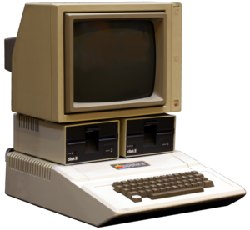
Time When the KMP Alg. Was Created
KMP was published in a journal paper in 1977
12" high resolution mode: 280×192
5.25" floppy 160KB~1.2 MB
Apple II
(1977)
Apple iMac
(2015)
38 yrs
Memory
4~64 KB
million ×
8GB
Frequency
1MHz
thousands ×
2~4GHz
Exhaustive
O(mn)
=
O(mn)
KMP
O(m+n)
=
O(m+n)

